Slide 1
NA1 – Network Abstractions
COMP 256 – Dickinson College
Prof. Braught
Spring 2023
Image from: https://dealna.com/Article/
Post/6564/Networking-Accessories

Slide 2

What is a computer network?
What is its purpose?
Notes:
Ask not because you are expected to have an answer.
But just to get your perspectives and take stock of our starting point.
The materials will cover everything we are expected to know about networks.

Slide 3

What is a network?
High Level View: Transports of information (files, data, audio, video, etc.) between application program running on different machines.
Low Level View: Transports 0’s and 1’s between devices directly connected by a (electrical, optical or radio) communication link.
Photo by: Steven Gerner, https://www.flickr.com/photos/
sgerner/16477700444/in/photostream/

Slide 4
The Internet
(5G)
(Zoom)
A “network of networks”
Interconnected internet service providers (ISPs)
Local Area Networks (LANs)
Wide Area Networks (WANs)
Image adapted from: http://gaia.cs.umass.edu/kurose_ross/videos/1/1/1.1_video_slides_posted.pptx
Notes:
We are going to focus on the internet here.
- It is a specific network.
- There are lots of other types of networks and lots of other things to know.
- The COMP 352 course on Networks is good for that.
- Here we wan to
- develop some understanding of how things fit together
- build some intuition about how things work that will provide hooks for future learning.
Internet is a network of neworks.
- Local area networks (LAN)
- Cover a small geographical area
- Run by one organization
- enterprise network (businesses, e.g. the College)
- home networks
- A cell in a cellular data network
- Short connections
- wire, WiFi, cellular to cell tower.
- Wide area networks (WAN)
- Cover large geographic areas
- Run by Internet service providers (ISPs)
- Longer connections
- Fiber-optic cables
Local traffic
- Internal to the LAN
Internet traffic
- Originates in a LAN
- Leaves the LAN
- Travels through the WAN
- Arrives at a destination LAN
- Delivered to destination

Slide 5
The Internet
(5G)
(Zoom)
Nodes
End Systems / Hosts
Clients, Servers
Laptops, phones,…
Source
Destination
Access Points
Hub, WiFi, Cellular
Switches / Routers
Edge Router
Communication Links
Wired
Optical
Radio
Image adapted from: http://gaia.cs.umass.edu/kurose_ross/videos/1/1/1.1_video_slides_posted.pptx
Notes:
Some vocabulary that we’ll need.
End Systems:
- Phones, laptops, desktops, servers
- Refrigerators, microwaves, picture frames, etc…
- Source is the originator of a transmission
- Destination is the target or recipient of a transmission.
Access Points:
- Point where end system connects to the network.
- Wired: Hubs (wired ethernet)
- Wireless: WiFi, Cellular
- Broadcast to devices, wired to network.
Switches / Routers:
- Internal to the network
- Direct and control the flow of traffic.
- Wired to access points and/or other routers
- Small number of wired connections…
- The edge router is the router where traffic leaves or arrives at the local network

Slide 6
The Internet
(5G)
(Zoom)
Low Level View:
Transports 0’s and 1’s between nodes over a direct communication link between them.
wire
optical fiber
radio signal
Image adapted from: http://gaia.cs.umass.edu/kurose_ross/videos/1/1/1.1_video_slides_posted.pptx

Slide 7
The Internet
(5G)
(Zoom)
High Level View:
Transports of information (files, data, audio, video, etc.) between application program running on different machines.
Web (HTTP)
E-mail
Video
Audio
…
Image adapted from: http://gaia.cs.umass.edu/kurose_ross/videos/1/1/1.1_video_slides_posted.pptx
Notes:
Between applications: Essentially to the applications it seems as if they are talking directly to each other.
- They open a connection and exchange messages.
- The rest of it is an abstraction that they use.
- How the information gets from source to destination is not a concern of the application in this high level view.
- E.g. Zoom on your machine talking to Zoom on another machine.
- E.g. Browser on your machine talking to web server on another machine (HTTP)
- E.g. Email program on your machine talking to the e-mail server on another machine (SMTP, IMAP)

Slide 8
The Internet
(5G)
(Zoom)
“Stuff” in the Middle
Process to Process
Transfer Control Protocol (TCP)
User Datagram Protocol (UDP)
Host to Host
Internet Protocol (IP)
Across a Single Link
Ethernet
WiFi
3,4,5G
(UDP)
Image adapted from: http://gaia.cs.umass.edu/kurose_ross/videos/1/1/1.1_video_slides_posted.pptx
Notes:
Process to Process:
- Within a machine there may be multiple programs “talking” to other programs on different machines.
- Your machine may have a Zoom connection to zoom on another machine,
- Your web browser may have multiple connections to web servers on other machines.
- Your e-mail program may have multiple connections to mail servers on other machines.
- We need a way to ensure that the incoming data from all of those connections gets to the correct process (application) within your machine.
- Can think of this using an apartment building metaphor:
- If we think of each machine as an apartment building
- It has an address.
- then each process will have an apartment number within the building.
- The Transfer Control Protocol (TCP) or User Datagram Protocol (UDP) is responsible for that.
- HTTP uses TCP
- Video streaming would used UDP
- More on those later.
Host to Host:
- Ultimately, though the information being transported between two end systems (hosts) it must move along a path through other nodes.
- E.g. Zoom – what path does the information take to get between these machines?
- The Internet Protocol (IP) is responsible for that.
- More on IP later.
- Metaphorically this is like a letter being delivered from one address to another (to the building but not to the apartment.)
Across a Single Link
- In order to move along a path from from end system to end system it must be able to move between two nodes.
- It is then just moved between pairs of nodes all along the path from source to destination.

Slide 9
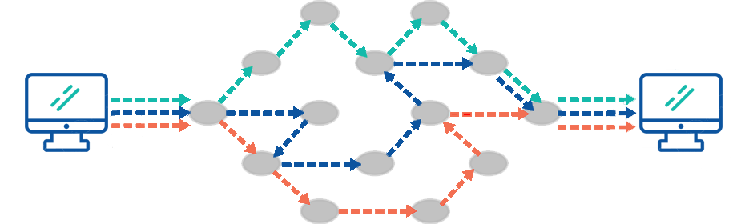
Packet Switched Networks
The Internet is a packet switched network.
Messages are divided into small chunks called packets.
Packets can take different paths from source to destination.
The communication links between nodes are shared.
Image from: https://www.apposite-tech.com/blog/packet-switching-vs-circuit-switching/
Notes:
Advantages of Packet switching
- This ensures reliable communication - Packets are rerouted in case of any problems..
- Sharing - packet switching makes use of available bandwidth efficiently.
- cost-effective.
Disadvantages of Packet switching
- If the network becomes overloaded, packets are delayed or discarded, or dropped.
- It is not secured if security protocols are not used during packet transmission.
List culled from : https://www.tutorialspoint.com/difference-between-circuit-switching-and-packet-switching

Slide 10
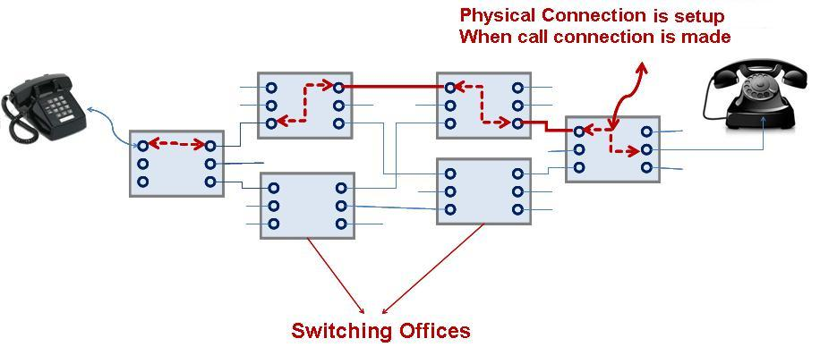
Circuit Switched Networks
In a Circuit Switched Network.
Dedicated circuits are allocated to each connection.
Circuits are maintained for as long as the connection is open.
Image from: https://www.apposite-tech.com/blog/packet-switching-vs-circuit-switching/
Notes:
Just as a counter point to packet switching.
- We will not be talking about further about circuit switched networks.
- The telephone network is the primary example of a circuit switched network.
Advantages of Circuit Switching
- A dedicated communication channel increases the quality of communication.
- Guaranteed data rate
Disadvantages of circuit switching
- Inefficient use of bandwidth
- Resources are not utilized fully.
- E.g. silent time wastes bandwidth because it cannot be used by others who may want more.
- Circuit switching is expensive.
List culled from : https://www.tutorialspoint.com/difference-between-circuit-switching-and-packet-switching

Slide 11
Network Layers (Abstractions)

Slide 12
Bridging the Chasm: By Metaphor
Getting you and your baggage from one place to another.
A process-oriented view.
Source
Destination
flight
flight
flight
Image adapted from: http://gaia.cs.umass.edu/kurose_ross/videos/1/5/1.5_video_slides_posted.pptx
Notes:
We’ll see that the process of transporting you and your baggage from one location to another is similar to transporting a message from one application to another.
The metaphor isn’t perfect… they never are…
- But its good enough to be useful.
- I’m going to stretch it here and there
- Some things will not quite be exactly like they happen in practice.
- But they will be close enough to be plausible and hopefully illustrative.
You and your baggage go through a process at the source of your trip.
- You specify your intended destination by purchasing a ticket.
- Once you have a ticket and are ready to travel you can check a bag at the airport.
- Once you check your bag, you proceed to a gate and get to load onto the plane.
- The plane then proceeds to a runway for takeoff.
- The plane then flies through the air to the destination.
When the plane arrives at the destination, everything that was done to make the actual transport possible must be undone.
- The plane lands on a runway and proceeds to a gate.
- You unload from the plane at a gate.
- You proceed to baggage claim and collect your checked baggage.
- Then if something were to have gone wrong you would interact with a customer service (or ticket agent) again.

Slide 13
Bridging the Chasm: By Metaphor
Getting you and your baggage from one place to another.
A service-oriented view.
Source
Destination
flight
flight
Image adapted from: http://gaia.cs.umass.edu/kurose_ross/videos/1/5/1.5_video_slides_posted.pptx
Notes:
The process-oriented view is pretty easy to follow.
But the service-oriented view is more useful when thinking about networks.
- And it gets at the heart of how abstractions are used in networks.
The way this works is that each layer provides a service by using the layers below it.
- For example, the ticketing service as gets you and your bags from source to destination.
- It of course doesn’t do all the work.
- It uses the lower-level services to accomplish that.
- But the point is that we can think of it as doing all of the work.
- They sell us a ticket from A to B
- Then use the service below (the abstraction) to take care of everything in between.
- The ticketing service can handle ticketing issues at the source or destination.
- But ticketing service does not know:
- where your bags will be checked, retrieved
- the gates that will be used for boarding and deplaning
- the runway that will be used for takeoff or landing.
- or the flight path that the plane will take
- They let the other services handle that (abstraction).
- We can think of the baggage service similarly.
- It gets your bags on the plane at the source and off of the plane at the destination (hopefully)
- Again, it doesn’t do it all
- It uses lower level services (abstractions) below to do everhting between getting the bags on the plane and getting the bags off of the plane..
- The baggage service does not know
- what gate will be used for boarding / deplaning
- the runways that will be used for takeoff and landing
- or the flight path that the plane will take
- Similarly for the gate service …
- It gets you on and off of the plane and then use the services (abstraction) to handle everything in between.
- And the runway service …
- It gets the plane into the air or onto the ground
- It uses the lower level services for everything in between.

Slide 14
Bridging the Chasm: By Metaphor
Getting you and your baggage from one place to another.
A service-oriented view.
MDT
Q74B9
ORD
F742
T2-C7
Source
T3-G21
T2-G19
Destination
R7
R2
flight
flight
Route
Image adapted from: http://gaia.cs.umass.edu/kurose_ross/videos/1/5/1.5_video_slides_posted.pptx
Notes:
Each service adds some additional information that is useful and meaningful to the service.
For example:
- The ticketing service
- When you buy a ticket you get a source and a destination and a confirmation number.
- This information is useful
- when you check in at the airport
- and if you need to discuss a complaint with a ticketing agent on arrival.
- Notice that this information is meaningful to both ends of this service.
- The baggage service
- Attaches a bag tag to your baggage
- Has information on it that will (hopefully) get your bag
- To the correct plane for departure
- From the plane to the correct baggage carrousel on arrival.
- Again, this information is meaningful to both ends of the baggage service
- But notice that it is not really useful to any higher level service.
- The gate service assigns
- A departure gate that will be used for loading the plane
- An arrival gate that will be used when unloading the plane
- The runway service assigns
- A departure runway for takeoff
- An arrival runway that will be used for landing
- The flight service transports you (the message) from the source to the destination along some route.
- Notice that in each case, the information added is useful to that service but not to any service above it.
- We’ll see this is the case with networking as well.
- Has the advantage that lower level services can be changed w/o impacting higher level services.
- E.g. Change 747 for DC10 aircraft – no problem.
Image adapted from: http://gaia.cs.umass.edu/kurose_ross/videos/1/

Slide 15
An Activity: Simplified Network Layers
Two students across the room from each other are designated as applications.
The students next to them are designated as the source and destination machines.
The students next to the source and destination machines are designated as the access points.
Everyone else is a router with communication links to their nearest neighbors.
Notes:
Source Application:
- Writes a message to the destination.
- Puts the message in an envelope.
- Writes own name and name of destination application and destination machine on the envelope.
- Hand envelope to source machine.
Source Machine:
- Write own name on the envelope
- Places envelope inside of another envelope.
- Write name of destination machine on the envelope.
- Hand it to the access point.
Source Access Point:
- Place envelope inside another envelope.
- Write name of an adjacent router on envelope.
- Hand that router the envelope.
Router:
- Open the envelope and remove inner envelope.
- Read name of destination.
- Place in another envelope.
- Write name of a router that is closer to the destination on envelope.
- Hand that router the envelope.
- Repeat until envelope is handed to destination access point.
Destination Access Point
- Open envelope and remove inner envelope.
- Hand envelope to the named destination machine.
Destination Machine
- Open envelope and remove the inner envelope.
- Hand envelope to the named application.
Destination Application
- Open the envelope and read the message.

Slide 16
Discussion Questions:
Do the access points or routers know the content of the messages they are passing?
Must all messages take the same route from source to destination?
What happens if a router or communication link goes down?
How does the destination application know where to send replies?
How can a machine have multiple networked applications running? Does the network know anything about this?

Slide 17
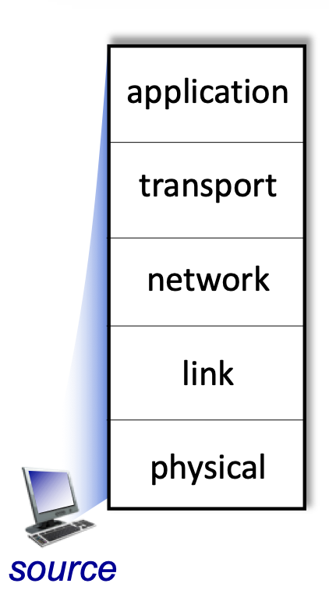
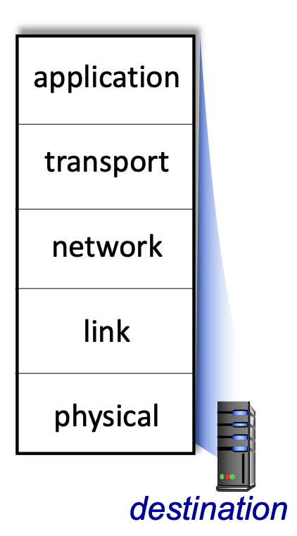
Bridging the Chasm: Network Layers
Getting information from one application to another.
Application Layer Service
HTTP
HTTP
TCP/
UDP
Transport Layer Services
TCP/
UDP
Source
Network Layer Services
Destination
IP
IP
Ether- net
Link Layer Services
Ether- net
Physical Layer Services
Wires
Wires
Image adapted from: http://gaia.cs.umass.edu/kurose_ross/videos/1/5/1.5_video_slides_posted.pptx
Notes:
The same thing happens in computer networks.
There are layers and each layer defines a service.
- Each service adds some information
- And then uses the next lower layer as an abstraction to perform that service.
For example:
- The source application knows:
- What it wants to send, where it is being sent from and where it wants to send it to.
- Like you purchasing an airline ticket and getting assigned a source and destination and confirmation number.
- The source application does not know:
- How to get that message to the application at the destination.
- But it doesn’t need to…
The application layer adds its information and passes the message off to the transport layer
The transport layer adds its information and passes it off to the network layer
The network layer adds its information and passes it off to the link layer
The link layer adds its information and passes it off to the physical layer
The physical layer transfers the message to a router…
- The router will need to rewrite some of the information in order to pass it along to the next rounter
- This would be like a flight with layovers
- There is landing runway and deplaning at the arrival gate
- Then a new departure gate and arrival assigned
- And a new takeoff and landing runway is assigned
- And a new flight route is plotted.
- But you don’t have to claim and recheck your bags, or get a new ticket.
It may require several hops to get to the
Then when the destination machine is reached
- It removes the information from each layer
- and ultimately delivers the message to the application.
So from the perspective of the applications, they are talking directly to each other.
- They are unaware of the information that is being added and removed.

Slide 18
Layer Responsibilities
Application Layer:
Programs exchange information using application specific messages that they understand.
E.g. A web browser talking to a web server.
Transport Layer:
OS adds/understands extra information to break message into smaller chunks (called packets), reassemble chunks into messages and deliver message to the target application on the destination machine.
Image adapted from: http://gaia.cs.umass.edu/kurose_ross/videos/1/5/1.5_video_slides_posted.pptx
Notes:
Application Layer was like application
- writing note to other application
- placing it in the envelope with the destination machine and application written on it.
Transport Layer would be like:
- OS on source deciding the message is too large and breaking it into smaller chunks.
- Could have torn the message in two and put it into two envelopes and numbered them.
- Then put each of those in its own envelope labeled with the destination machine.
- OS at destination
- Collects packets and reassembles them into the message
- Delivers the message to the application.

Slide 19
Layer Responsibilities
Network Layer:
Routers add/understand extra information that is used to direct messages from router to router to move them from source to destination.
Link Layer:
Network interface cards add/understand extra information to pass messages between two neighboring nodes.
Physical Layer:
Physically transmits bits across a communication link.
Image adapted from: http://gaia.cs.umass.edu/kurose_ross/videos/1/5/1.5_video_slides_posted.pptx
Notes:
Network Layer was like each router
- Opened the envelope it received to see where the message was headed.
- Found a router that is closer to the destination
- Put the message in an envelope with the address of that router
Link Layer
- We ignored this in our activity.
- This would be sort of like translating the name of the next router to its physical location
- Look at the name, and then translate that to, hand this to your right.
Physical Layer
- We also ignored this in our activity.
- It would be sort of like
- rewriting everything on and in all of the envelopes as a long string of 1’s and 0’s
- then passing those 1’s and 0’s to the next device
- then it would reassemble them into new envelopes with the same content and information.

Slide 20
Network Data Encapsulation
Data
Data
Data
Data
Link Layer Info
Network Layer Info
Message
Transport Layer Info
Application
Layer Info
Notes:
The message and other layer information becomes the data being transferred by the next lower service.
- This is like placing the message in the envelope
- and that envelope in another envelope
- and so on.

Slide 21
The Physical Layer

Slide 22
The Physical Layer
Physically transmits bits across a communication link.
Serial Transmission: Bits are sent and received one at a time, one after the other.
Parallel Transmission: Multiple bits are sent simultaneously on separate wires, fibers or channels.

Slide 23
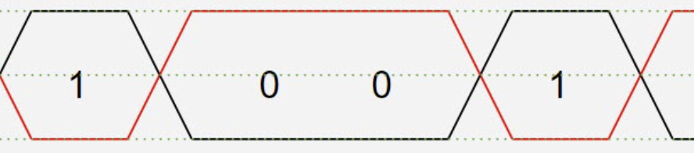

Physical Layer Encodings
A network interface encodes bits as electrical signals on wire(s), as light pulses through a fiber optic cable or on radio waves in the air.
Differential
Pair Encoding
Frequency
Shift Keying
Encoding
Notes:
Differential pair image from: https://www.microcontrollertips.com/what-is-differential-signaling-faq/
Frequency encoding image from: https://www.tmatlantic.com/encyclopedia/index.php?ELEMENT_ID=10422

Slide 24
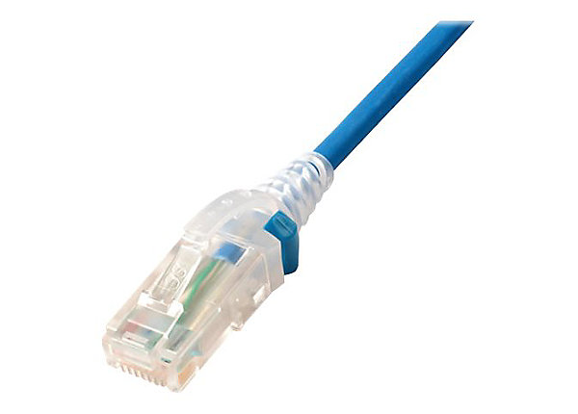
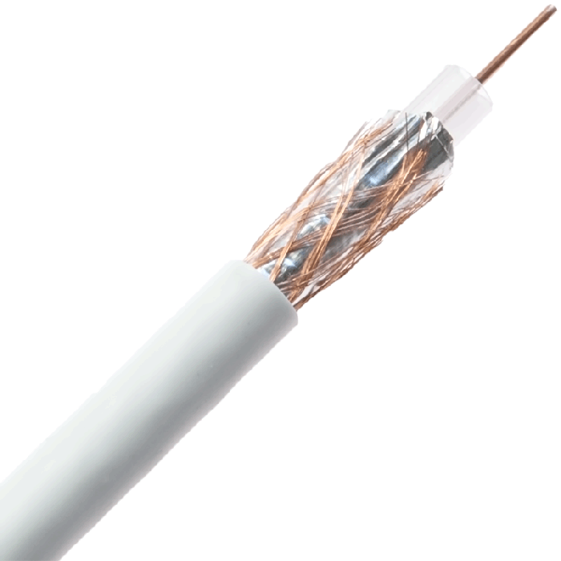
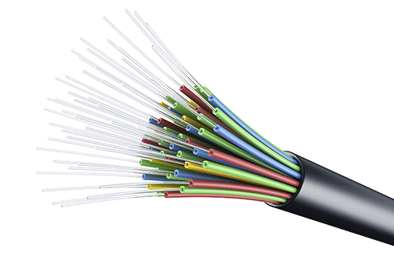
Physical Layer Speeds
The bandwidth of a communication link is the maximum number of bits that can be transferred per unit of time and is property of the physical medium and the connectors.
Twisted
Pair
Coaxial
Cable
Fiber Optic
Cable
WiFi
Cellular
100’s Mbps
per
channel
100 Mbps –
10 Gbps
10 Gbps –
100’s Gbps
100 Mbps –
1 Gbps
50 Mbps -
1 Gbps (5G)
Image adapted from: http://gaia.cs.umass.edu/kurose_ross/videos/1/2/1.2_video_slides_posted.pptx

Slide 25
Network Speeds
The data rate (or throughput) is the number of bits of information that are actually transferred per unit of time.
The data rate is a property of the hosts, network layers, network interfaces and the bandwidth of the communication links.

Slide 26


Acknowledgments
Slide Template From:
https://creativecommons.org/licenses/by/4.0/
Slide Content Licensed as:
Creative Commons Attribution-NonCommercial-ShareAlike 4.0 International License.
Notes:
Note: Individual images may be covered by their own licensing agreements and were incorporated here under fair use. Their use in this slide deck does not change or alter their licensing.

Slide 27
PROTOCOL’s HERE?
Messages for interaction between machines within a layer.
Within a layer across machines?

Slide 28
Protocols
For communications within a layer
Notes:
Ticketing agents can talk
Baggage check people can talk

Slide 29
Protocol Types
Connection-oriented
Connectionless
Reliable
Best Effort

